Slide 1
Service-Oriented Architecture for a Healthcare System
Presented By:
Harshitha N

Slide 2
Service-Oriented Architecture:
Introduction
Service-oriented architecture (SOA) is a method of software development that uses software components called services to create business applications. Each service provides a business capability, and services can also communicate with each other across platforms and languages. Developers use SOA to reuse services in different systems or combine several independent services to perform complex tasks.

Slide 3
SOA creates interoperability between apps and services. It ensures existing applications can be easily scaled, while simultaneously reducing costs related to the development of business service solutions.
Enterprises also use SOA to build applications that require multiple systems to interact with each other efficiently. The defining concepts of SOA are the following:
Business value is more important than technical strategy.
Strategic goals are more important than benefits related to specific projects.
Basic interoperability is more important than custom integration.
Shared services are more important than implementations with a specific purpose.
Continuous improvement is more important than immediate perfection.

Slide 4
Case Study: Service-Oriented Architecture for a Healthcare System
Overview
A large healthcare provider, HealthCare Co, faced challenges in managing patient data, streamlining operations, and ensuring regulatory compliance due to the fragmented nature of their IT systems. Different departments (e.g., patient records, billing, lab services, pharmacy) operated in silos, leading to inefficiencies and data inconsistencies. To address these issues, HealthCare Co decided to implement a Service-Oriented Architecture (SOA) to integrate its disparate systems and improve overall healthcare delivery.

Slide 5
Objectives:
Integrate various healthcare IT systems.
Improve data consistency and accuracy across departments.
Enhance operational efficiency and patient care.
Enable real-time data access and reporting.
Ensure compliance with healthcare regulations (e.g., HIPAA).
Provide scalability and flexibility for future needs.

Slide 6
Implementation
1. Assessment and Planning
Stakeholder Analysis: Identify key stakeholders (HR managers, IT staff, department heads).
Requirements Gathering: Conduct workshops to gather detailed requirements.
System Analysis: Review existing HR systems to understand data structures, processes, and integration capabilities.
2. Architecture Design
Service Identification: Identify key services required for the HR system (e.g., Employee Management, Payroll, Recruitment, Training).
Service Definition: Define the scope and functionality of each service.
Service Contracts: Establish service contracts detailing the inputs, outputs, and protocols for each service.

Slide 7
3. Development and Integration
Service Development: Develop services using a suitable technology stack (e.g., RESTful APIs, SOAP).
Integration Layer: Implement an integration layer using an Enterprise Service Bus (ESB) to facilitate communication between services and legacy systems.
Data Transformation: Use data transformation tools to ensure data consistency across different systems.
4. Deployment
Testing: Conduct thorough testing (unit, integration, system, and user acceptance testing) to ensure the services meet requirements.
Pilot Deployment: Deploy the solution in a pilot region or department to identify and resolve any issues.
Full Deployment: Roll out the solution across all regions and departments
5. Monitoring and Maintenance
Monitoring Tools: Implement monitoring tools to track the performance and availability of services.
Feedback Loop: Establish a feedback loop with stakeholders to gather input for continuous improvement.
Regular Updates: Plan for regular updates and maintenance to address evolving needs and technological advancements.

Slide 8
Key Services and Components
Patient Management Service
Appointment Scheduling Service
Electronic Medical Records (EMR) Service
Billing Service
Pharmacy Service

Slide 9
Benefits:
Improved Data Consistency: Centralized data management ensures that all healthcare providers have access to the same information, reducing discrepancies.
Enhanced Efficiency: Automated processes and integrated systems reduce manual work, allowing healthcare staff to focus on patient care.
Real-Time Access to Information: Real-time data integration enables healthcare providers to access up-to-date patient information, improving decision-making and care coordination.
Scalability: The SOA-based system can easily scale to accommodate new services, facilities, and increased patient volume.
Flexibility: The modular nature of SOA allows Health Plus to quickly adapt to changes in healthcare requirements, regulations, and technologies.

Slide 10
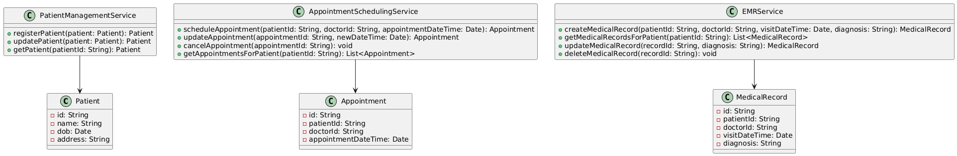
Class Diagram

Slide 11
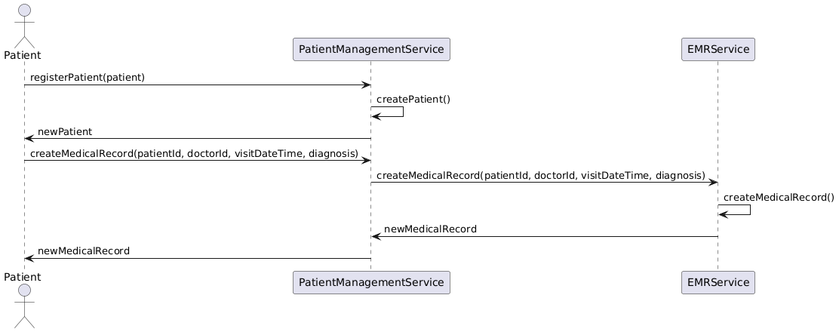
Sequence Diagram

Slide 12
Conclusion
By implementing a Service-Oriented Architecture for its healthcare system, Health Plus was able to overcome the challenges of disparate systems, achieving significant improvements in data consistency, process efficiency, and patient care. The SOA approach provided the flexibility and scalability needed to support Health Plus's growth and evolving healthcare needs.

